Slide 1


introduction,
searching,
insertion and
deletion

Slide 2

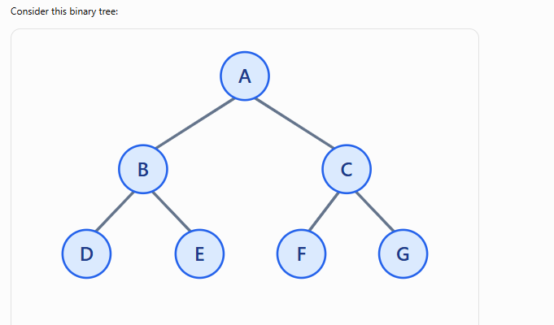

Array Representation of a Binary Tree

Slide 3
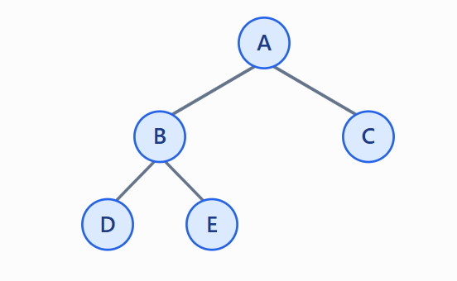
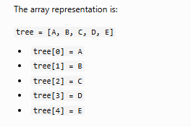
Array Representation of a Binary Tree

Slide 4
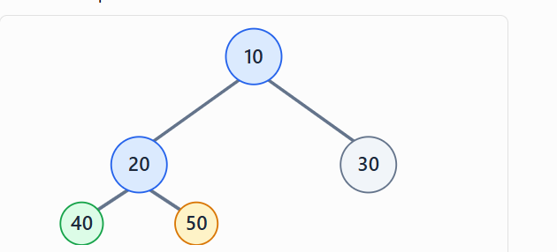

Array Representation of a Binary Tree

Slide 5
Array Representation of a Binary Tree
Advantages
Easy to implement: Stores tree nodes in an array.
Fast access: Finds parent and children using formulas.
No pointers needed: Saves pointer memory.
Best for complete trees: Uses array space efficiently.

Slide 6
Array Representation of a Binary Tree
Disadvantages
Memory wastage: Empty positions waste space.
Fixed size: The array has limited capacity.

Slide 7
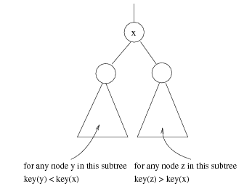
Binary Search Trees (BST)
A data structure for efficient searching, insertion and deletion
Binary search tree property
  For every node X
  All the keys in its left
  subtree are smaller than
  the key value in X
  All the keys in its right
  subtree are larger than the
  key value in X

Slide 8

Binary Search Trees
A binary search tree
Not a binary search tree

Slide 9

Binary Search Trees
The same set of keys may have different BSTs
Average depth of a node is O(log N)
Maximum depth of a node is O(N)

Slide 10
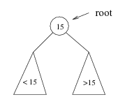
Searching BST
If we are searching for root (15), then we are done.
If we are searching for a key < root , then we should search in the left subtree.
If we are searching for a key > root, then we should search in the right subtree.

Slide 11
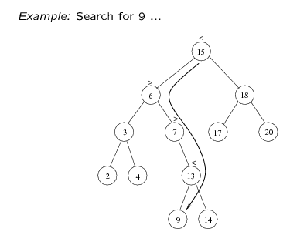
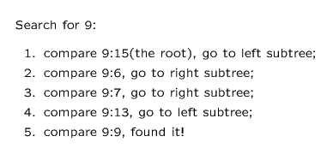

Slide 12
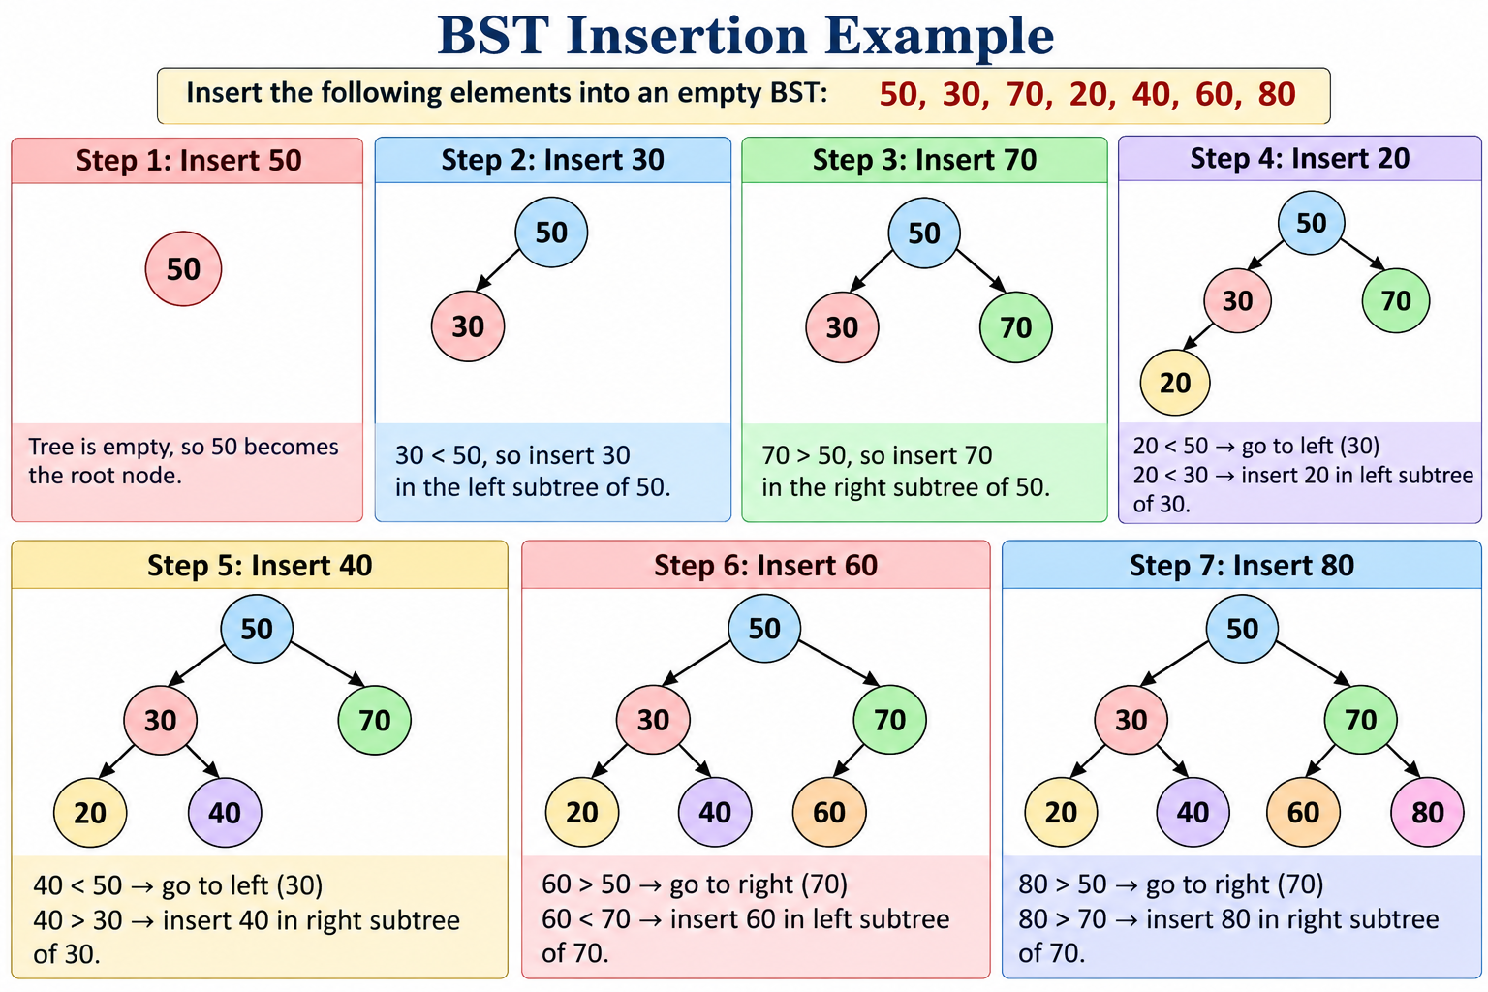
Tree Using Array – Insert
Remember the BST rule:
Smaller value → Left subtree
Greater value → Right subtree

Slide 13
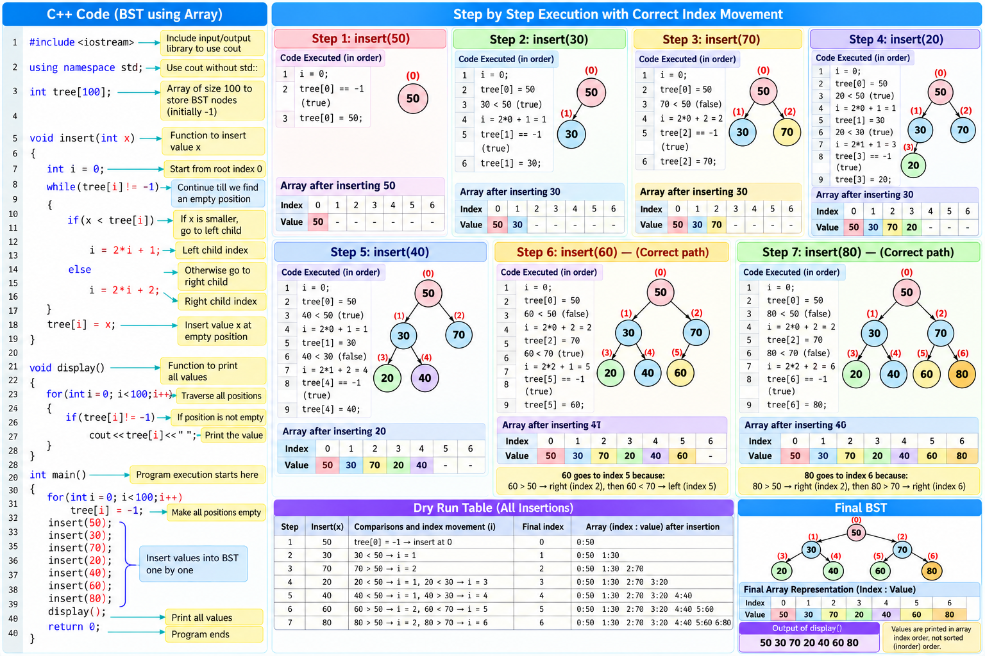
Tree Using Array – Insert , Display

Slide 14
Tree Using Array – Insert , Display
#include <iostream>
using namespace std;
int tree[100];
void insert(int x)
{
int i=0;
while(tree[i]!=-1)
{
if(x<tree[i])
i=2*i+1; // Go left
else
i=2*i+2; // Go right
}
tree[i]=x; // Insert value
}
void display()
{
for(int i=0;i<100;i++)
{
if(tree[i]!=-1)
cout<<tree[i]<<" ";
}
}
int main()
{
// Make all positions empty
for(int i=0;i<100;i++)
tree[i]=-1;
insert(50);
insert(30);
insert(70);
insert(20);
insert(40);
insert(60);
insert(80);
display();
return 0;
}

Slide 15
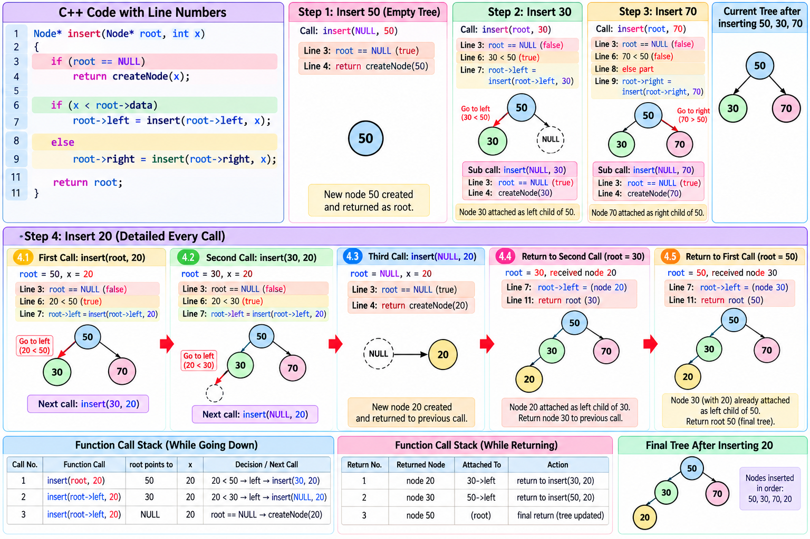
Tree Using Array – Insert , Display

Slide 16
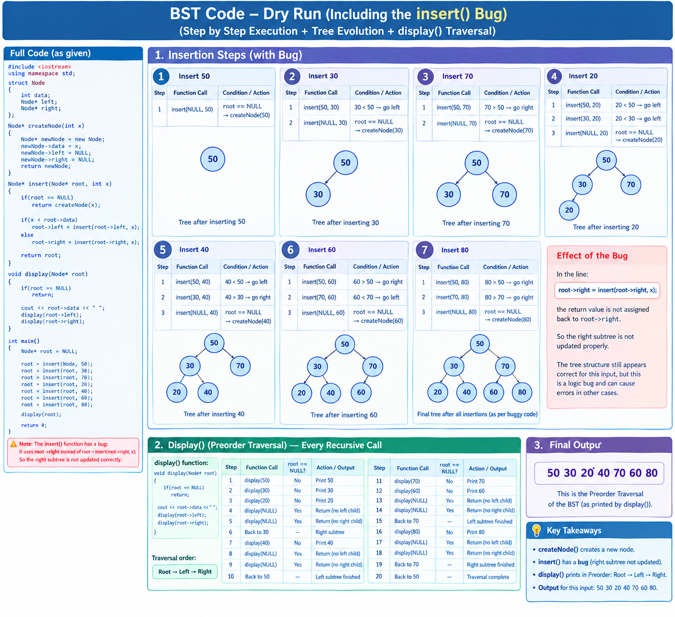
Tree Using Array – Insert , Display

Slide 17
Tree Using Array Insert , Display - Deep
#include <iostream>
using namespace std;
// Array to store the Binary Search Tree
// Maximum 100 positions are available
int tree[100];
// Function to insert a value into BST
void insert(int x)
{
// Start from root
// Root is always stored at index 0
int i = 0;
// Keep moving until we find an empty position
// Here -1 means the position is empty
while(tree[i] != -1)
{
// If new value is smaller than current node
// we have to go to the LEFT side
if(x < tree[i])
{
// For array representation:
// LEFT CHILD = 2*i + 1
i = 2*i + 1;
}
else
{
// If new value is greater than or equal
// to current node, go to RIGHT side
//
// RIGHT CHILD = 2*i + 2
i = 2*i + 2;
}
}
// We reached an empty position
// Store the new value at this position
tree[i] = x;
}
// Function to display the array
void display()
{
cout << "BST Array:" << endl;
for(int i=0; i<100; i++)
{
// Only display positions which are not empty
if(tree[i] != -1)
{
cout << "Index " << i << " = " << tree[i] << endl;
}
}
}
int main()
{
// Initially make every position empty
// -1 means EMPTY
for(int i=0; i<100; i++)
{
tree[i] = -1;
}
// Insert values one by one
insert(50);
insert(30);
insert(70);
insert(20);
insert(40);
insert(60);
insert(80);
// Display the BST
display();
return 0;
}

Slide 18
Tree Using Linked List Insert , Display

Slide 19
Tree Using Linked List Insert , Display
#include <iostream>
using namespace std;
struct Node
{
int data;
Node* left;
Node* right;
};
Node* createNode(int x)
{
Node* newNode = new Node;
newNode->data = x;
newNode->left = NULL;
newNode->right = NULL;
return newNode;
}
Node* insert(Node* root, int x)
{
if(root == NULL)
return createNode(x);
if(x < root->data)
root->left = insert(root->left, x);
else
root->right = insert(root->right, x);
return root;
}
void display(Node* root)
{
if(root == NULL)
return;
cout << root->data << " ";
display(root->left);
display(root->right);
}
int main()
{
Node* root = NULL;
root = insert(root, 50);
root = insert(root, 30);
root = insert(root, 70);
root = insert(root, 20);
root = insert(root, 40);
root = insert(root, 60);
root = insert(root, 80);
display(root);
return 0;
}

Slide 20
Tree Using Linked List Insert , Display - Deep
#include <iostream>
using namespace std;
// Structure of one node
struct Node
{
int data; // Stores the value
Node* left; // Pointer to the left child
Node* right; // Pointer to the right child
};
// Function to create a new node
Node* createNode(int x)
{
Node* newNode = new Node; // Create a node dynamically
newNode->data = x; // Store the value in the node
newNode->left = NULL; // Initially, no left child
newNode->right = NULL; // Initially, no right child
return newNode; // Return the address of the new node
}
// Function to insert a value into the BST
Node* insert(Node* root, int x)
{
// If the tree or subtree is empty, insert here
if(root == NULL)
return createNode(x);
// If the value is smaller, go to the left subtree
if(x < root->data)
root->left = insert(root->left, x);
// If the value is greater than or equal, go to the right subtree
else
root->right = insert(root->right, x);
// Return the root of the current subtree
return root;
}
// Function to display the BST in preorder
void display(Node* root)
{
// Stop if there is no node
if(root == NULL)
return;
// 1. Print the root node
cout << root->data << " ";
// 2. Display the left subtree
display(root->left);
// 3. Display the right subtree
display(root->right);
}
int main()
{
// Initially, the tree is empty
Node* root = NULL;
// Insert the first value; it becomes the root
root = insert(root, 50);
// Insert the remaining values
root = insert(root, 30);
root = insert(root, 70);
root = insert(root, 20);
root = insert(root, 40);
root = insert(root, 60);
root = insert(root, 80);
// Display the tree in preorder
display(root);
return 0; // End the program
}

Slide 21
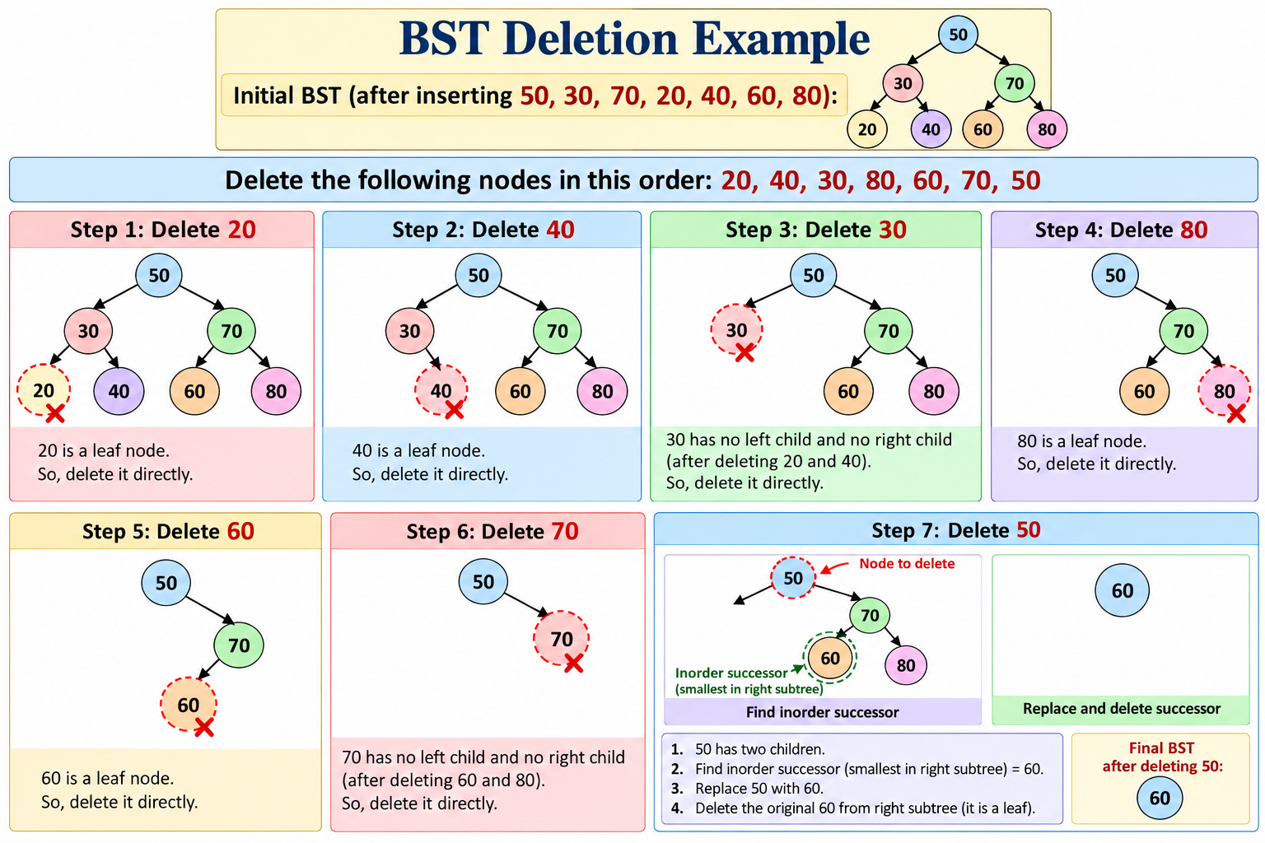
Tree Using Array – Delete
Case 1

Slide 22
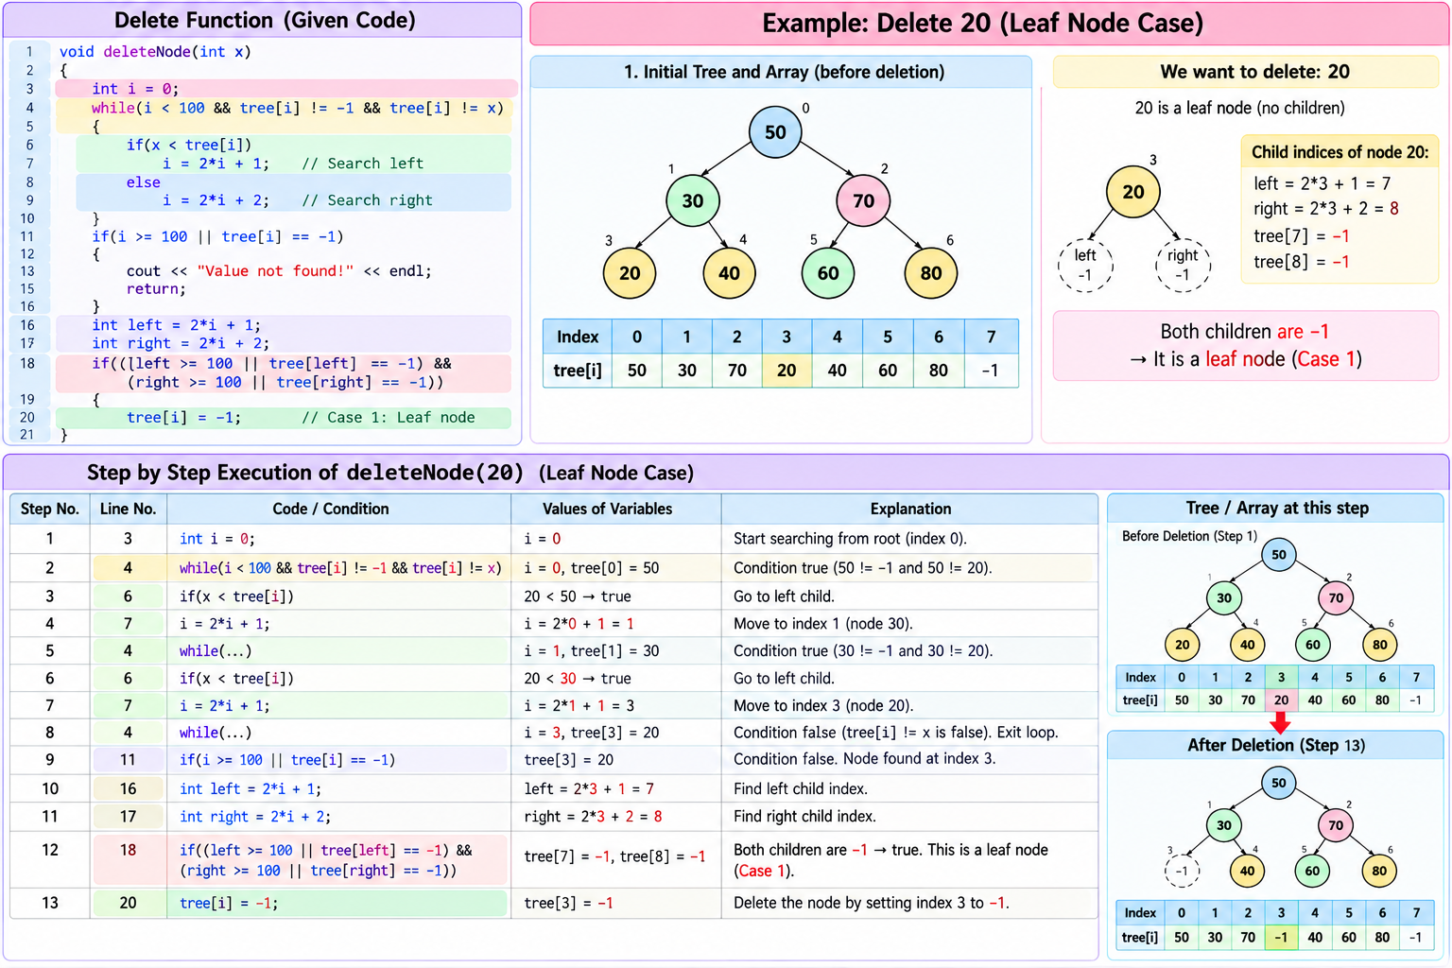
Tree Using Array – Delete
Case 1

Slide 23
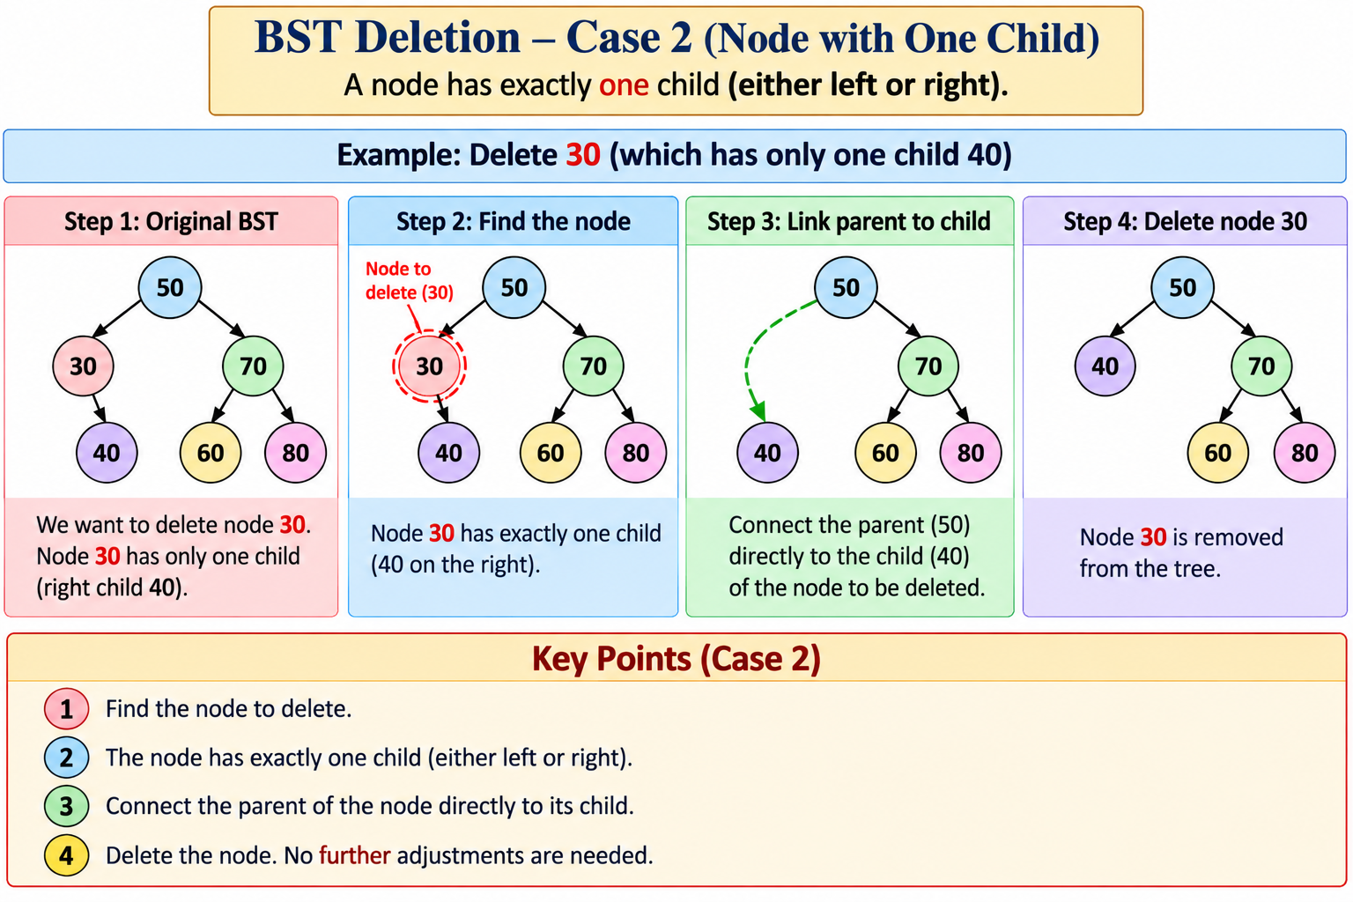
Tree Using Array – Delete

Slide 24
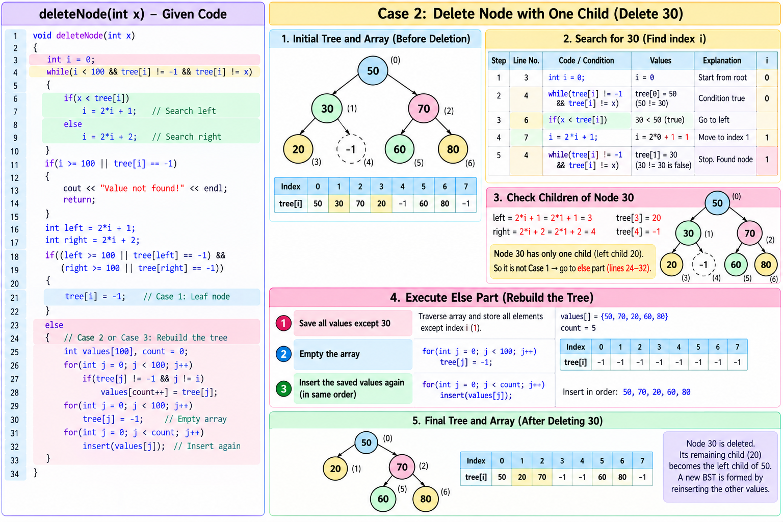
Tree Using Array – Delete

Slide 25
Tree Using Array – Delete
Inorder Successor: It is the smallest value in the node’s right subtree.
Inorder Predecessor: It is the largest value in the node’s left subtree.

Slide 26
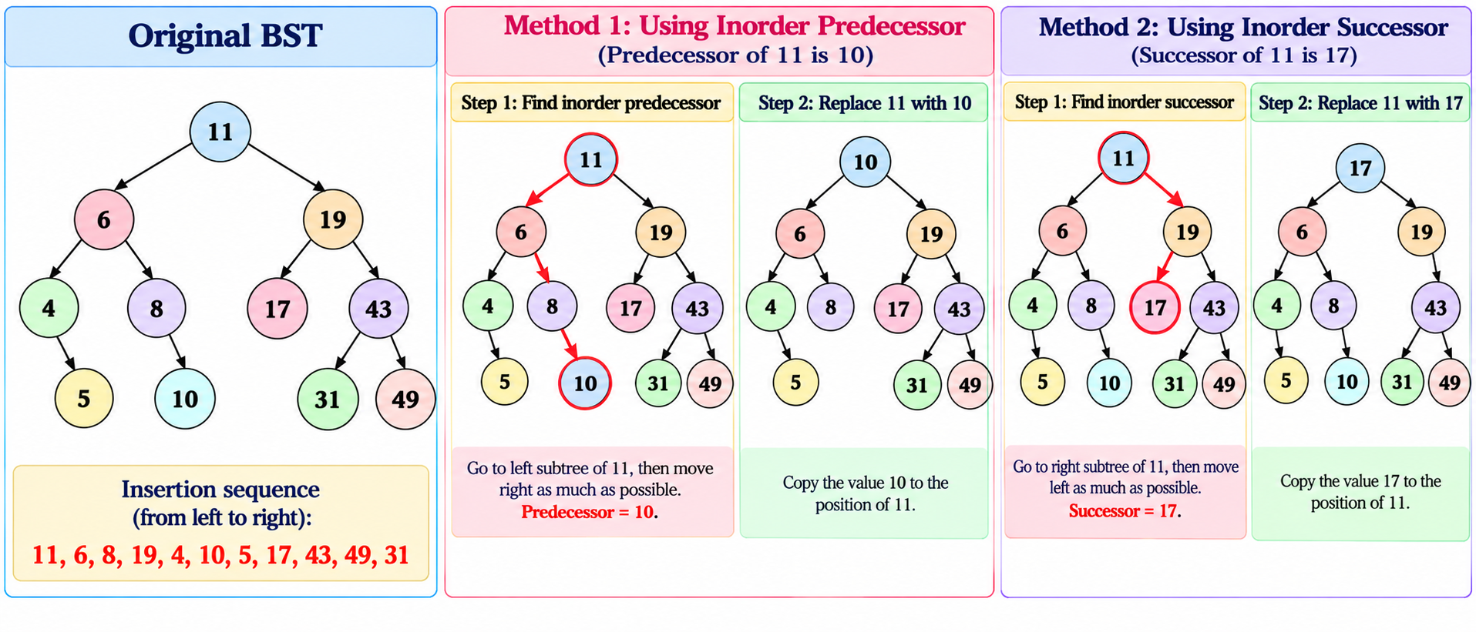
Tree Using Array – Delete
Case -3

Slide 27
Tree Using Array – Delete
#include <iostream>
using namespace std;
// Array to store the BST
int tree[100];
// Insert a value into BST
void insert(int x)
{
int i = 0;
// Find an empty position
while(i < 100 && tree[i] != -1)
{
if(x < tree[i])
i = 2*i + 1; // Left child
else
i = 2*i + 2; // Right child
}
// Store the value
if(i < 100)
tree[i] = x;
}
// Delete a value from BST
void deleteNode(int x)
{
int i = 0;
// Search for the value
while(i < 100 && tree[i] != -1 && tree[i] != x)
{
if(x < tree[i])
i = 2*i + 1; // Search left
else
i = 2*i + 2; // Search right
}
// If value is not found
if(i >= 100 || tree[i] == -1)
{
cout << "Value not found!" << endl;
return;
}
// Find child positions
int left = 2*i + 1;
int right = 2*i + 2;
// CASE 1: Node has no children
// Example: Delete 20 when it is a leaf
if((left >= 100 || tree[left] == -1) &&
(right >= 100 || tree[right] == -1))
{
tree[i] = -1;
}
else
{
int values[100];
int count = 0;
// CASE 2: Node has one child
// Example: Delete 30 when it has only child 40
//
// CASE 3: Node has two children
// Example: Delete 50 when it has children 30 and 70
//
// Save all values except the one being deleted
for(int j = 0; j < 100; j++)
{
if(tree[j] != -1 && j != i)
{
values[count] = tree[j];
count++;
}
}
// Empty the tree array
for(int j = 0; j < 100; j++)
tree[j] = -1;
// Insert the saved values again
// This rebuilds the BST
for(int j = 0; j < count; j++)
insert(values[j]);
}
}
// Display the BST array
void display()
{
cout << "BST Array:" << endl;
for(int i = 0; i < 100; i++)
{
if(tree[i] != -1)
cout << "Index " << i << " = " << tree[i] << endl;
}
}
int main()
{
// Initially, all positions are empty
for(int i = 0; i < 100; i++)
tree[i] = -1;
// Create the BST
insert(50);
insert(30);
insert(70);
insert(20);
insert(40);
insert(60);
insert(80);
cout << "Original BST:" << endl;
display();
// CASE 1: Delete leaf node 20
deleteNode(20);
// CASE 2 example: Delete node 30
// Its remaining child is 40 after deleting 20
deleteNode(30);
// CASE 3 example: Delete node 50
// It has two children in the current tree
deleteNode(50);
cout << "\nBST after deletion:" << endl;
display();
return 0;
}

Slide 28

Tree Using Array – Delete
Case 2 , Case 3

Slide 29
Tree Using Array - Delete
#include <iostream>
using namespace std;
// Array to store the Binary Search Tree
// Maximum 100 positions are available
int tree[100];
// Function to insert a value into BST
void insert(int x)
{
// Start from root
// Root is always stored at index 0
int i = 0;
// Keep moving until we find an empty position
// Here -1 means the position is empty
while(tree[i] != -1)
{
// If new value is smaller than current node
// we have to go to the LEFT side
if(x < tree[i])
{
// For array representation:
// LEFT CHILD = 2*i + 1
i = 2*i + 1;
}
else
{
// If new value is greater than or equal
// to current node, go to RIGHT side
//
// RIGHT CHILD = 2*i + 2
i = 2*i + 2;
}
}
// We reached an empty position
// Store the new value at this position
tree[i] = x;
}
// Function to display the array
void display()
{
cout << "BST Array:" << endl;
for(int i=0; i<100; i++)
{
// Only display positions which are not empty
if(tree[i] != -1)
{
cout << "Index " << i << " = " << tree[i] << endl;
}
}
}
int main()
{
// Initially make every position empty
// -1 means EMPTY
for(int i=0; i<100; i++)
{
tree[i] = -1;
}
// Insert values one by one
insert(50);
insert(30);
insert(70);
insert(20);
insert(40);
insert(60);
insert(80);
// Display the BST
display();
return 0;
}

Slide 30
